Slide 1

Module 2 – SMA-X Service Asset & Configuration Management
January 2018
Notes:
[STANDARD SLIDE: L300 (animated)]
You can change out the photo with any image from Getty Images in DropBox.
If the main title is shorter, you can make the font larger.
You may have to move the title text around depending on the photo. Make sure the text is readable against the background photo.
You can change the background color for the rectangle in the bottom-right corner to look better against the background. Choose a Micro Focus color at 25% transparency.
=========================
Note to Narrator or Reader: [PRESS] indicates press the Page Down key to show the animation
=========================
Hello and Welcome to the [COURSE_NAME] Technical Overview Training, Level 300.
In this course you’ll gain a high-level understanding of the essentials of [PRODUCT_NAME].
[PRESS] If you want to download this presentation and save it on your own system, click the Tools & Help icon in the bottom-right corner of your window and select Download.
Or, if you want to access the PPT slides and speaker notes for future reference, go to the Attachments tab in your window click to download the presentation.

Slide 2
Objectives
After completing this module, you should be able to:
Describe the key features of Service Asset and Configuration Management
Navigate SACM interface
Understand SACM Modeling
Use Impact Analysis
Work with Asset Models, Stock Management, Locations & Reservations
Navigate and Use Contracts
Manage Vendors

Slide 3
SACM features

Slide 4
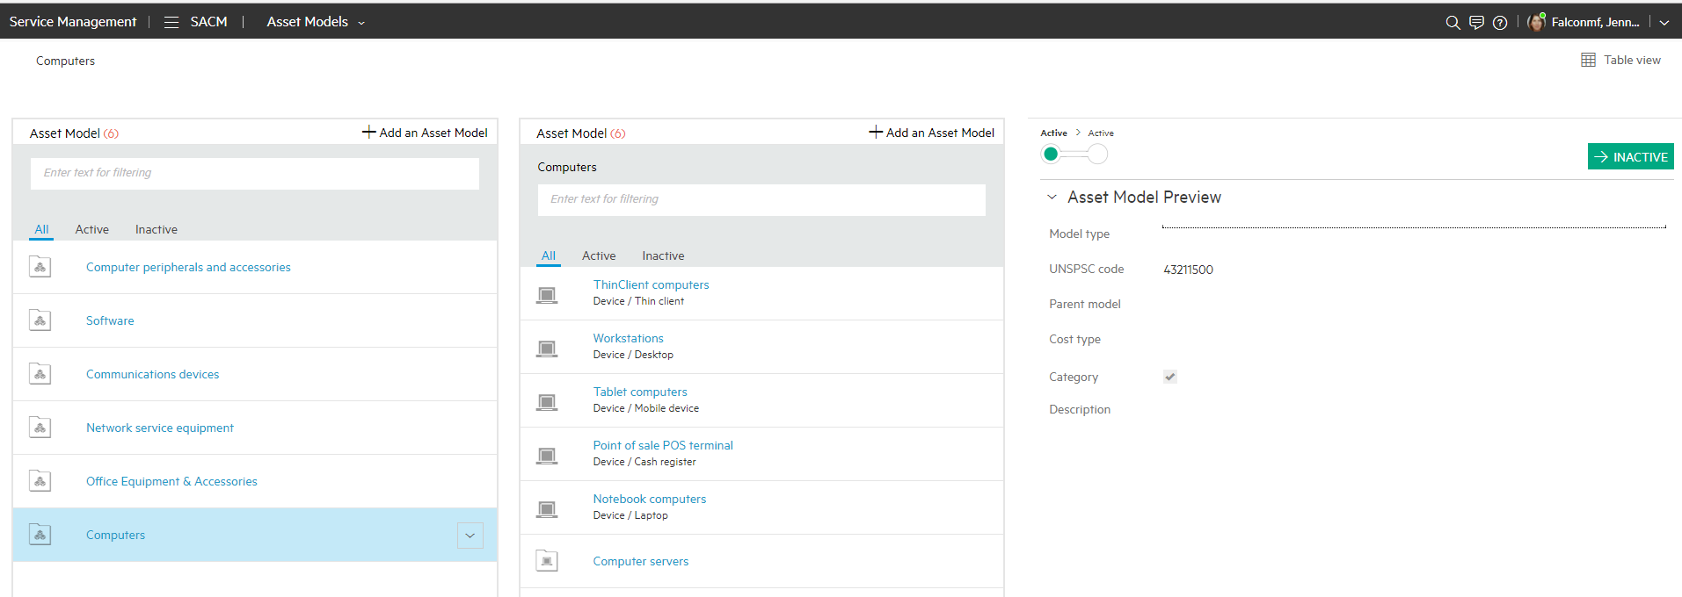
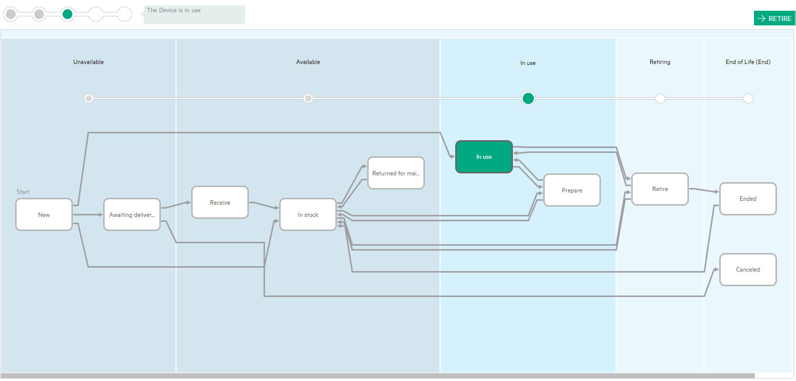
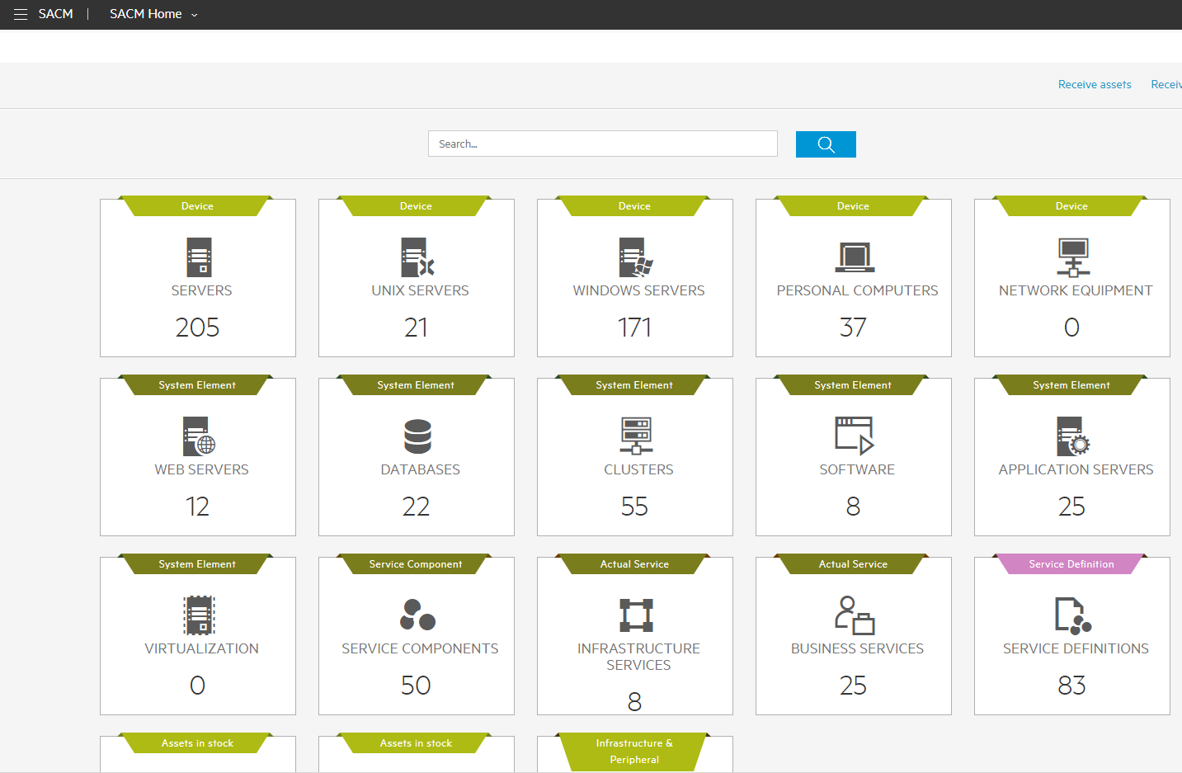
Service Asset and Configuration Management
Optimize asset utilization and contract value. Reconcile finance and IT views.
Asset Tracking
Asset Portfolio dashboard
Asset modeling, asset types and sub-types, aligned with UNSPSC
Manage types of assets: Device, License, Infrastructure & Peripheral
Understand where they are, who is using them and their status
Manage lifecycle and contractual information
Financial asset information; Purchase price, resale, taxes, fixed asset reconciliation
Enhanced Configuration Management
Integration with UCMDB/UD over the On-Premise Bridge
Manage complex attributes (e.g. CPUs)
Drill down into UCMDB browser
Asset reconciliation and normalization
Improve your asset portfolio with data enrichment rules
Immersive IT Asset Management
Widget displaying related contracts on asset and service
Notes:
Service Asset and Configuration Management
Service management administrators and other personnel need current information about business services and devices to close defects, fulfill change requests, and solve problems. Most business services depend on hardware and software to run efficiently. When there is an outage, the interruption can affect the entire organization, a special group, or just a few individuals.
Service Asset and Configuration Management (SACM) is the process that is responsible for both Configuration Management and Asset Management. SACM helps you organize and track the individual assets that support your business services.
Terminology
The ITIL v3 glossary has complete definitions for most SACM terms. Service Anywhere focuses on these terms in particular

Slide 5
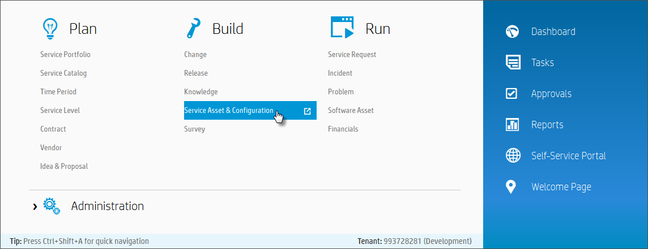
IT Agent Accessing SACM
Mega Menu > Build > Service Asset & Configuration

Slide 6
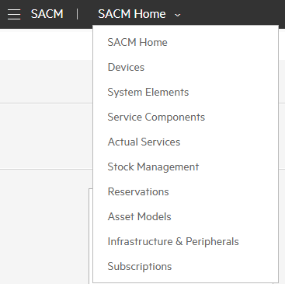
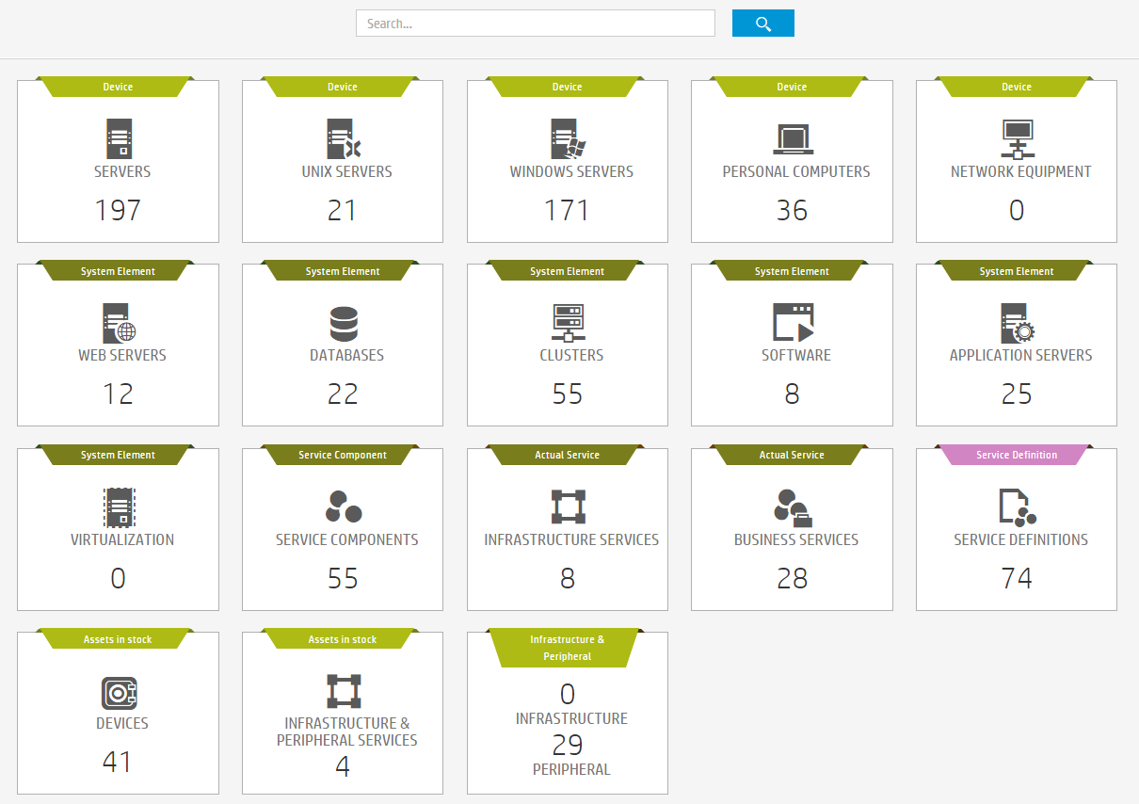
IT Agent Accessing SACM
SACM Home page & Submenus
Global Search
Widget by object type

Slide 7
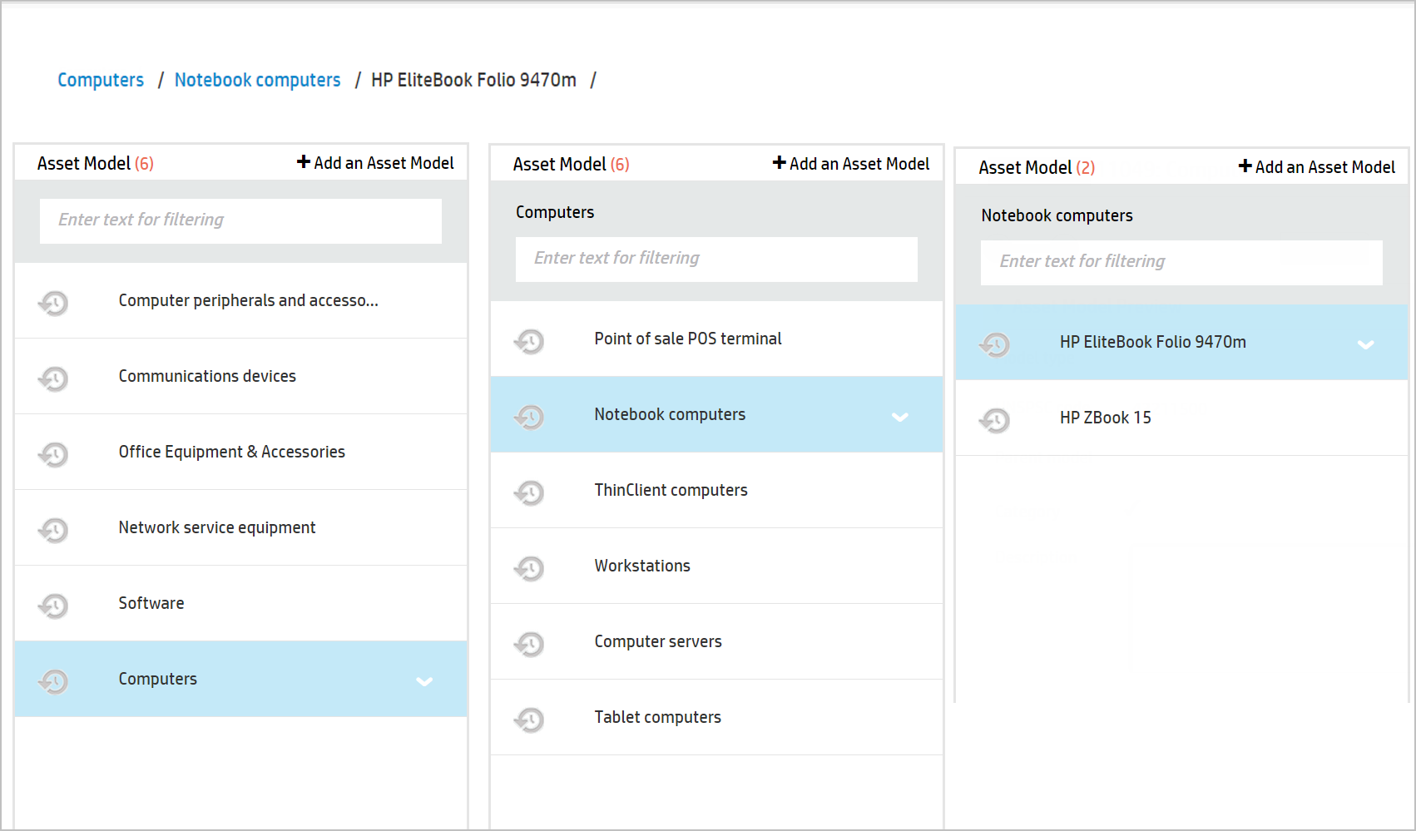
Asset Models
SACM → Asset Models
Multi-level classification applied to help manage assets
Similar models have similar information

Slide 8
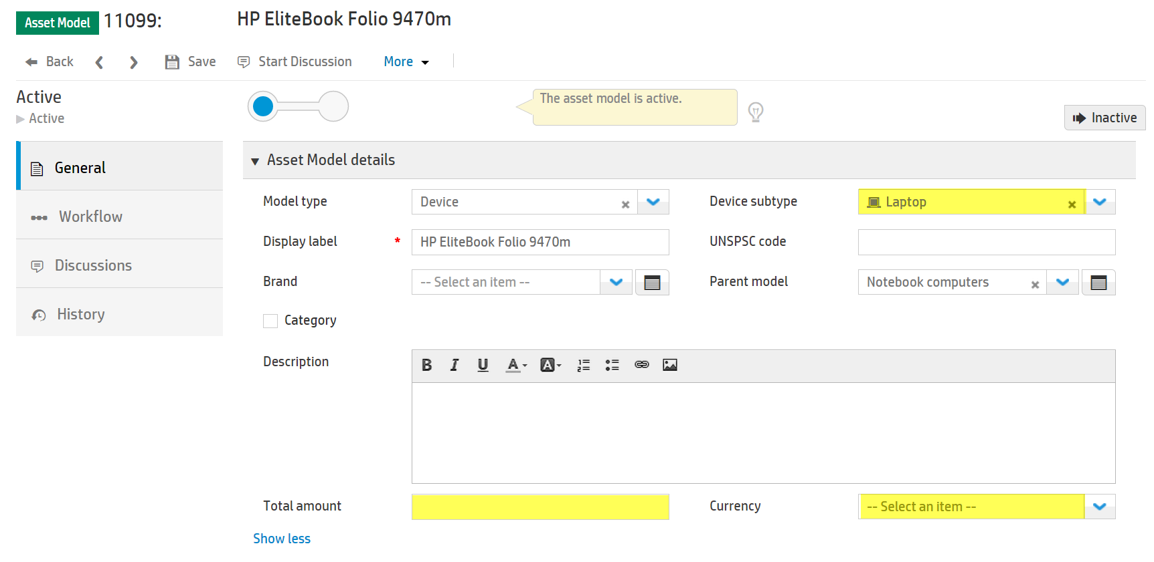
Asset Models
SACM → Asset Models
Model type
Subtype
UNSPSC code
Brand
Parent Model
Price & Currency
Workflow
Active or Inactive

Slide 9
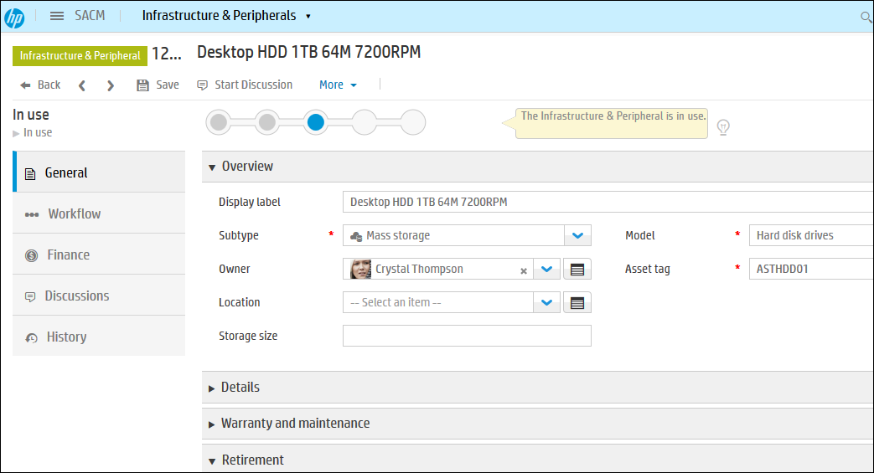
Infrastructure & Peripheral Assets
Mega Menu > Build > Service Asset & Configuration > Infrastructure & Peripherals
Infrastructure and peripheral assets include, but are not limited to items such as:
Monitor
Mass storage
RFID
Projector
Rack
Cooling systems
Fire protection systems
Telecommunication
and more…

Slide 10
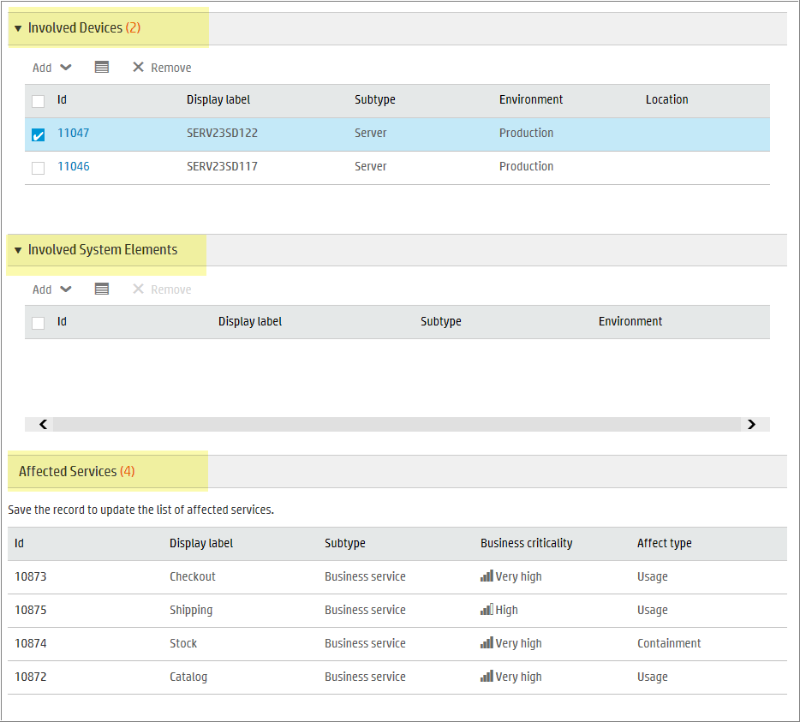
SACM
Involved Cis and SACM model
Requests, Incidents & Problems
Actual service (Referenced)
Involved CIs
Devices
System elements
+ Involved Infrastructure & peripherals
+ Involved Licenses
Changes
Actual service (Referenced)
Involved CIs
Devices
System elements
+ Involved Infrastructure & peripherals
+ Involved Licenses
Actual service (Affected)

Slide 11
SACM Model and Lifecycles

Slide 12
SACM Model Hierarchy
The SACM Model is a framework to define, manage and track all individual components that support the organizational business services.
Each hierarchical level in the model is a container for one or more components
Categorization
Category defined in the Service Catalog top level.
Service Definition
Each category contains one or more services. The Service Definition is a high-level description of the provided service Eg. Payroll
Actual Service
These are business services consumed by End Users. Eg. Payroll
SACM
Model
Service Component
One or more components required to support an actual service. Eg. Payroll Application, Payroll Database
One or more elements required to support a service component. Eg. Jboss app server supports the Orders application
System Element
Device
Servers, computers, VMs and other nodes
Notes:
SACM Model
The model is a framework to define, manage, and track all individual components that support organizational business services.
Each hierarchical level in the model is a container for one or more components.
The Service Catalog provides a list of supported business services that end users can request. The list of available services are organized into categories, such as application services or communications services.
The Service Asset and Configuration Management model uses the category information provided in a service request. The category determines which path to follow through the Service Asset and Configuration Management model to access an individual device that supports a business service in that category.
Category: Categorization Service Catalog and Service Requests
Service Definition: Global description of provided services
Actual Service: One or several instances of one service. Business service or Infrastructure service
Service Component: Subset of the service (Application components)
System Element: Enables the service to be available
Device: Individual Configuration Item

Slide 13
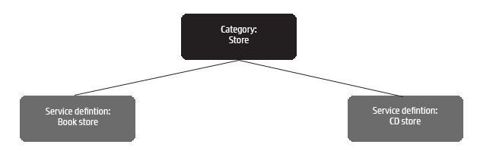
SACM System Definition
System Definition
Each category contains one or more service definitions.
A service provides value to the end user and supports their goals.
A service definition is a high-level description of the provided service.
The service definition also groups actual services that are part of the same domain.
Service Definition
Actual Service
Service Component
System Element
Device
Notes:
The Service Anywhere model is a framework to define, manage, and track all individual components that support your organizational business services. Each hierarchical level in the model is a container for one or more components. The Service Catalog provides a list of supported business services that end users can request. The list of available services are organized into categories, such as application services or communications services.
The Service Asset and Configuration Management model uses the category information provided in a service request. The category determines which path to follow through the Service Asset and Configuration Management model to access an individual device that supports a business service in that category. The following diagram shows the complete Service Asset and Configuration Management model that depends on the category specified in the service request.
Service definition
Each category contains one or more service definitions. A service provides value to the end user and supports their goals. A service definition is a high-level description of the provided service. The service definition also groups actual services that are part of the same domain.
In the following example, there are four categories. Each category contains definitions for the services that belong to that category.
Example
Store (category)
Book Store (service definition)
CD Store (service definition)
In this example, you can see how the category specified by a service request can determine the entry point of the SACM model. Book store and CD store are the service definitions that belong to the category of Store.

Slide 14
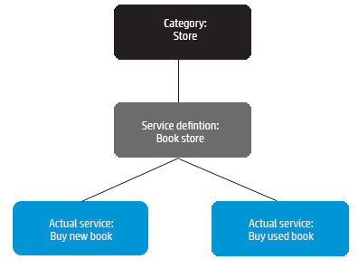
SACM Actual Service
Actual Service
Each service definition contains zero or more actual services.
The actual service is an instance of a service that benefits end users.
It might be a business service or an infrastructure service.
An actual service can also be a non-technical service, such as a mailbox where you deliver letters and other physical documents.
Service Definition
Actual Service
Service Component
System Element
Device
Notes:
Actual service
Each service definition contains zero or more actual services. The actual service is an instance of a service that benefits end users. It might be a business service or an infrastructure service. An actual service can also be a non-technical service, such as a mailbox where you deliver letters and other physical documents.
In this example, Buy new book and Buy used book are actual services that belong to the Book Store service definition. Buy new CD and Buy used CD are actual services that belong to the CD Store service definition.
Example
Store (category)
Book Store (service definition)
Buy new book (actual service)
Buy used book (actual service)
CD Store (service definition)
Buy new CD (actual service)
Buy used CD (actual service)
Note that in this example, the actual services are business services consumed by an end user. The following diagram shows the relationships among the Store category, Book Store service definition, and the dependent actual services.

Slide 15
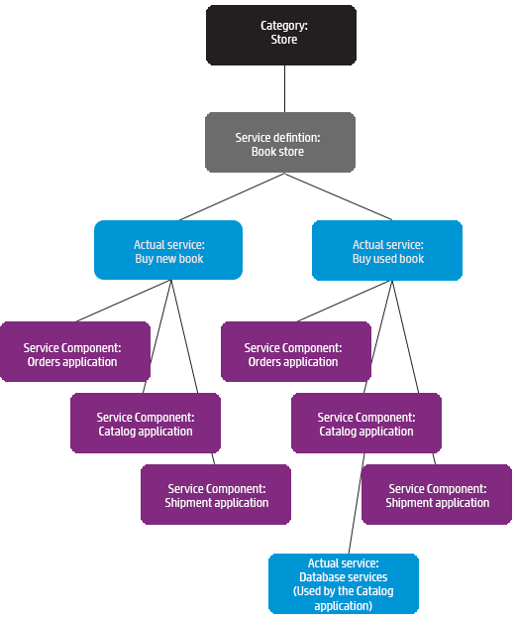
SACM Service Component
Service Component
Each actual service contains one or more service components.
Each service component can support one or more actual services.
Service Definition
Actual Service
Service Component
System Element
Device
Notes:
Service component
Each actual service contains one or more service components. Each service component can support one or more actual services.
The service component and the actual service represent the business service logic of the organization in the Service Asset and Configuration Management data model.
Example
Store (category)
Book Store (service definition)
Buy new book (actual service)
Orders application (service component)
Catalog application (service component)
Shipment application (service component)
Buy used book (actual service)
Orders application (service component)
Catalog application (service component)
Shipment application (service component)
CD Store (service definition)
...
In this example, the actual services each contain three service components. These service components are the Orders, Catalog and Shipment application. Each component supports the actual service. An service component can also depend on another actual service. For example, the Catalog application uses Database services.

Slide 16
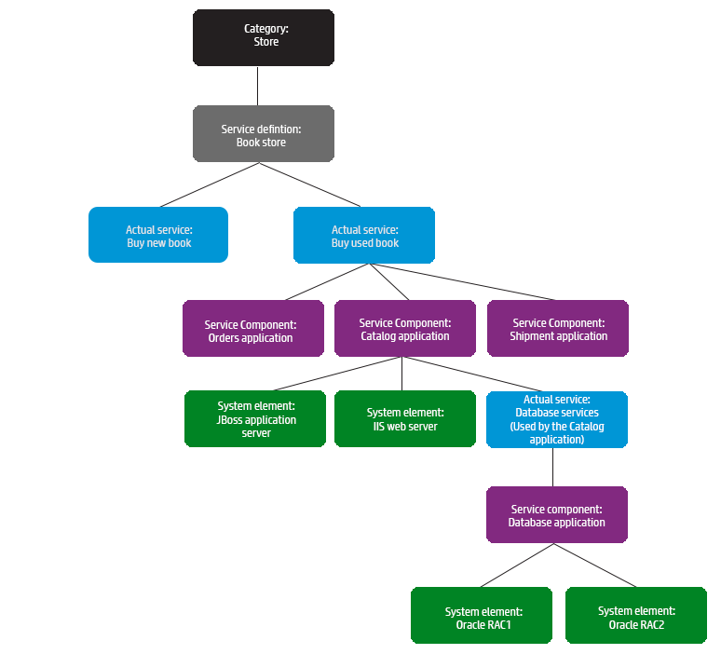
SACM System Element
System Element
A system element is required functionality that supports a business service component.
A system element enables the service to be available to an end user.
A complex system that serves a major enterprise can require a cluster of interconnected nodes.
Each service component contains zero or more system elements.
Service Definition
Actual Service
Service Component
System Element
Device
Notes:
System element
A system element is the functionality supported by a device. For example, a server is a device. When this server runs a specific set of applications, it becomes a web server. The web server is the system element. The parent service component is a complete application system that depends on the web service (a system element) to make the actual service available to an end user.
Each service component contains zero or more system elements.
Each system element contains zero or more devices.
Each system element can support zero or more service components.
For example, an application server and web server are necessary to support an online book ordering system. A database is also essential to store customer and order I
Example:
Store (category)
Book Store (service definition)
Buy new book (actual service)
...
Buy used book (actual service)
Orders application (service component)
...
Catalog application (service component)
JBoss application server (system element)
IIS web server (system element)
Shipment application (service component)
...
CD Store (service definition)
...
In this example there are two system elements contained in the Catalog application. Each system element is defined by a record that is related to the subordinate device records.
Note: This example also shows how a service component can also depend on an actual service (Database services) that has its own service component (a database application) and system elements (Oracle instances).
Information captured in the online book ordering system.

Slide 17
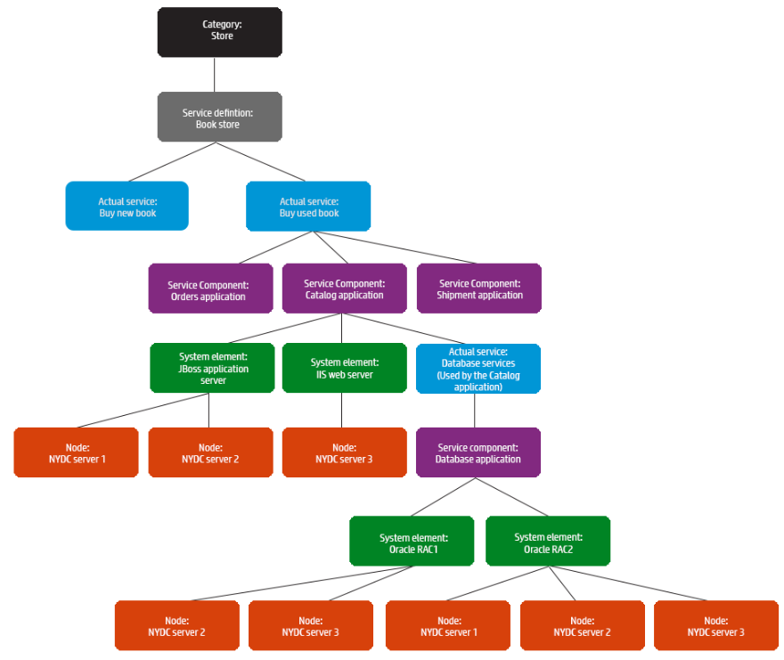
SACM Device
Device
Each system element contains zero or more devices.
Each device supports a system element.
Devices are often known as configuration items.
In the HP Software Universal Data Model (UDM) Specification, a device is equivalent to a node configuration item in most cases.
In some cases, a device is equivalent to a node element.
Service Definition
Actual Service
Service Component
System Element
Device
Notes:
Device
It is helpful for end users to understand the role of devices in the SACM model, and how they relate to the traditional UDM classification.
In the HP Software Universal Data Model (UDM) Specification, a device configuration item is a node with one or more node elements.
In Service Anywhere:
Each system element contains zero or more devices.
Every device supports a system element.
A device is a type of configuration item.
Examples:
A computer that is visible on a network
A firewall that is not visible on a network
Servers, desktop computers, switches, and routers
Example
Store (category)
Book Store (service definition)
Buy new book (actual service)
....
Buy used book (actual service)
Orders application (service component)
....
Catalog application (service component)
JBoss application server (system element)
NYDC server 1 (node)
NYDC server 2 (node)
IIS web server (system element)
NYDC server 3 (node)
Shipment application (service component)
....

Slide 18
SACM Typology Examples
Hierarchy
Category
Service definition
Actual service
Business service
Infrastructure service
System element
Running software
Web server
Database
Virtualization
Application server
CI collection
Other
Device
Server
Desktop
Laptop
Network equipment
Mobile device
VoIP equipment
Cluster resource group
Network printer
Unknown
Actual service
SACM
Model
Service component
System element
Device
Notes:
Service Asset and Configuration Management model
The Service Anywhere model is a framework to define, manage, and track all individual components that support your organizational business services. Each hierarchical level in the model is a container for one or more components. The Service Catalog provides a list of supported business services that end users can request. The list of available services are organized into categories, such as application services or communications services.
The Service Asset and Configuration Management model uses the category information provided in a service request. The category determines which path to follow through the Service Asset and Configuration Management model to access an individual device that supports a business service in that category. The following diagram shows the complete Service Asset and Configuration Management model that depends on the category specified in the service request.
Service definition
Each category contains one or more service definitions. A service provides value to the end user and supports their goals. A service definition is a high-level description of the provided service. The service definition also groups actual services that are part of the same domain.
Actual service
Each service definition contains zero or more actual services. The actual service is an instance of a service that benefits end users. It might be a business service or an infrastructure service. An actual service can also be a non-technical service, such as a mailbox where you deliver letters and other physical documents.
Service component
Each actual service contains one or more service components. Each service component can support one or more actual services.
The service component and the actual service represent the business service logic of the organization in the Service Asset and Configuration Management data model.
System element
A system element is the functionality supported by a device. For example, a server is a device. When this server runs a specific set of applications, it becomes a web server. The web server is the system element. The parent service component is a complete application system that depends on the web service (a system element) to make the actual service available to an end user.
Each service component contains zero or more system elements.
Each system element contains zero or more devices.
Each system element can support zero or more service components.
Device
It is helpful for end users to understand the role of devices in the SACM model, and how they relate to the traditional UDM classification.
In the HP Software Universal Data Model (UDM) Specification, a device configuration item is a node with one or more node elements.
In Service Anywhere:
Each system element contains zero or more devices.
Every device supports a system element.
A device is a type of configuration item.

Slide 19
Service Modeling
CI Types
Definitions
CI Relationship Rules and Examples
Service Definition
A High level definition of Actual Service types
May have multiple containment links of Actual Services
Examples: Mail Services
1:*
Actual Service
Usage
Defines a specific Service that we offer externally or internally
In UCMDB referred to as ‘Business Service’ or ‘Infrastructure Service’
May have multiple containment links of Service Components
May have multiple usage links to other Actual Services.
Examples: Mail Service–SD, Mail Service-NY
Containment
*:*
Usage
Service Component
Breaks up the Actual Service to multiple components
In UCMDB usual referred to as ‘Business Application’
May have multiple containment links of System Elements
May have multiple usage links of Actual Services
Examples: Exchange – Application, Exchange – SQL Server, Exchange – Home Grown Add on
Containment
*:*
System Element
Defines the Capability that the Device offers to the Service Component
May have multiple containment links of Devices
System Element may represent a
Running Software
Cluster
Virtualization
Generalized Grouping
Containment
*:*
Device
Represents Computers/Network Devices (Physical & Virtual)
In UCMDB usual referred to as ‘Node’

Slide 20
UCMDB Synchronization
SMA-X CI | Matching UCMDB CIs | UCMDB TQL Queries
Device | node | SACM Node Push
ActualService | Service | SACM Service Push
ServiceComponent | BusinessApplication | SACM Service Component Push
SystemElement | ApplicationSystem, RunningSoftware and CICollection | SACM CI Collection to System Element Push SACM System Element Push

Slide 21
SACM Modeling Relationship to Service Catalog
Offering
Fulfilment plan
Category
Service definition
Actual service
Service component
System element
Device

Slide 22
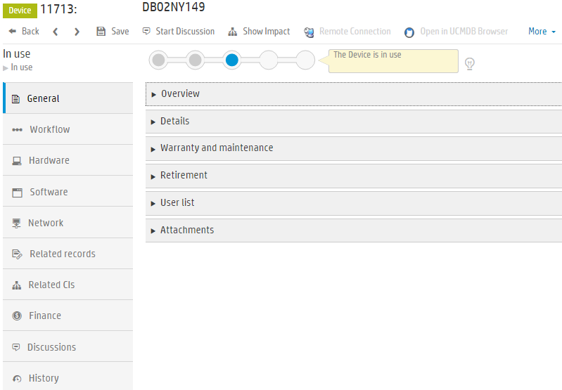
SACM Device – record content

Slide 23
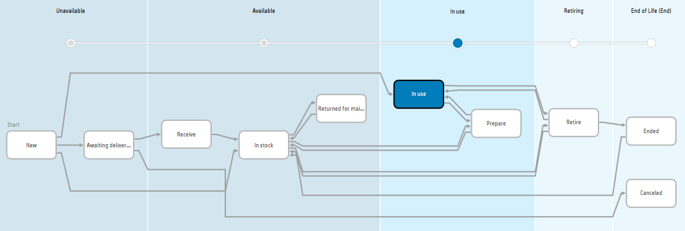
SACM Device Lifecycle

Slide 24
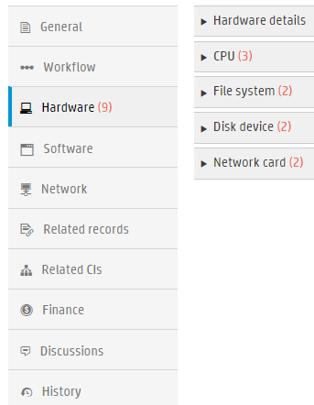
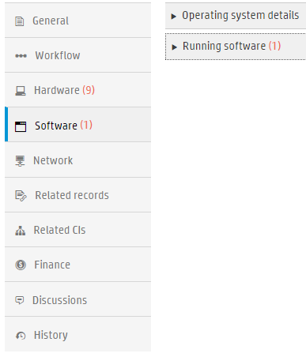
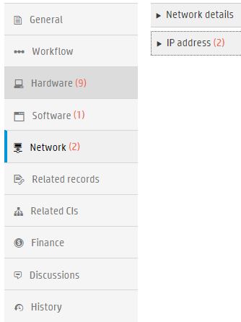
SACM Device Record content sub-tabs

Slide 25
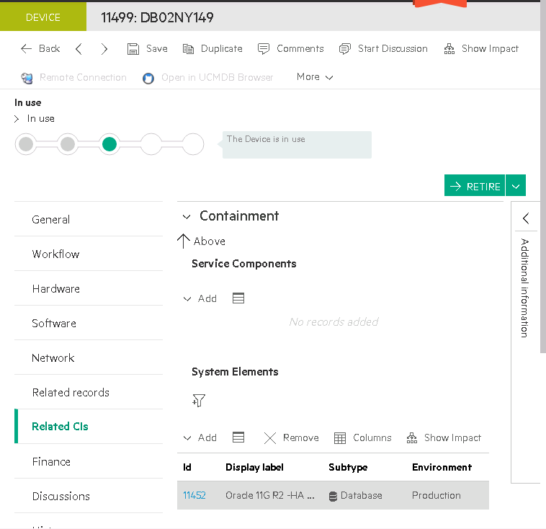
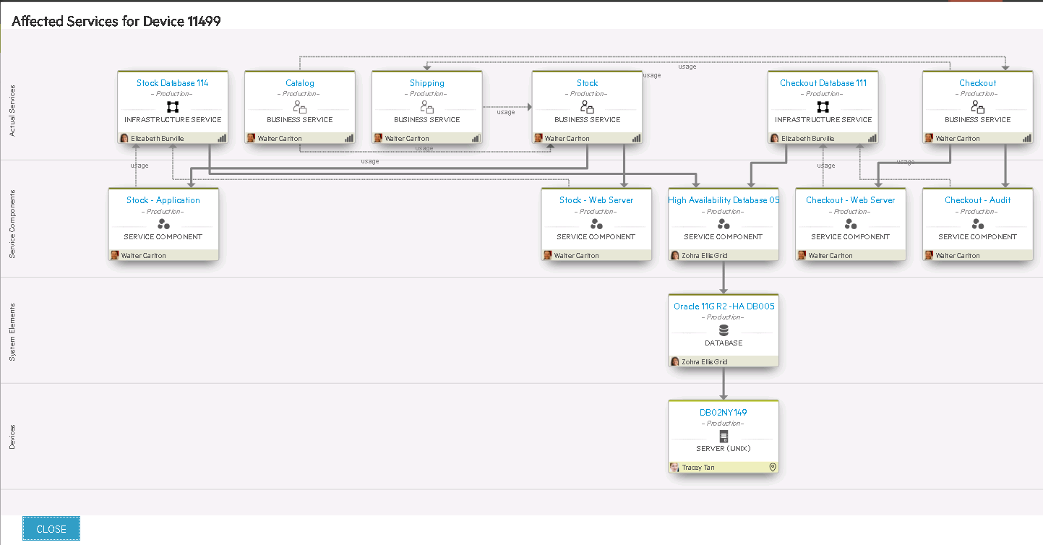
SACM Device – Related CIs and Show Impact map
Tabular and graphical formats

Slide 26
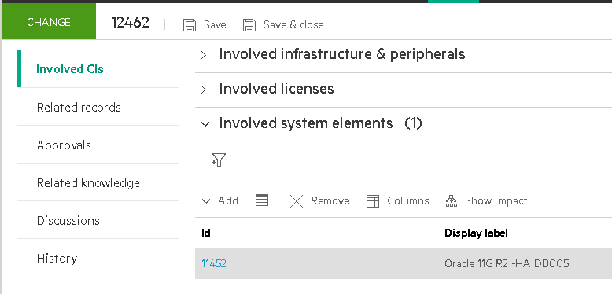
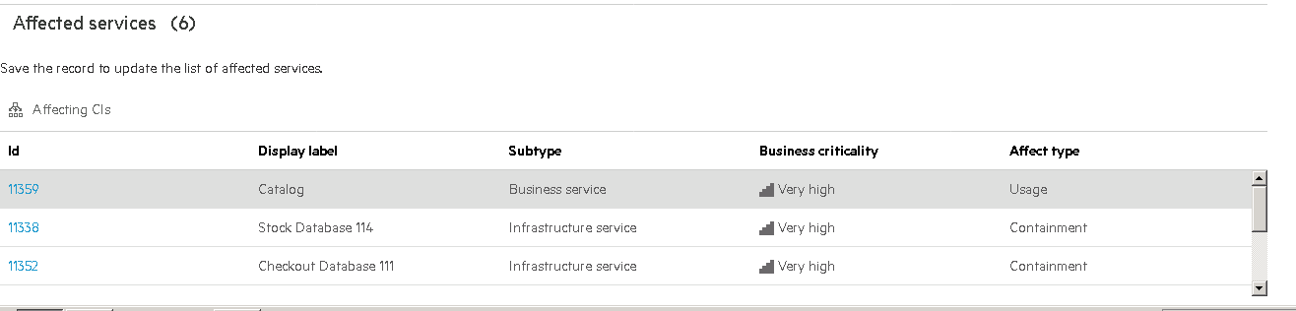
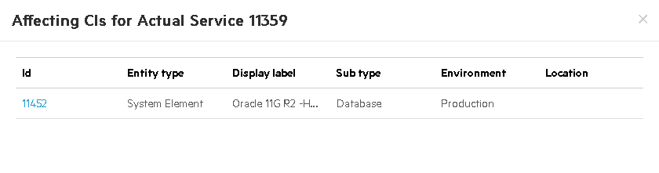
Impact Analysis
Bottom-up analysis
Top-down analysis
from any Involved CI list (Incident, Problem, Change) can “Show Impact”
Access quick view of relevant “Affecting CIs” associated with an Affected service in a change record
Notes:
To access, navigate to a Change. In the “Involved Cis” tab, add an Involved Device , select it, and press the “Show Impact” button.

Slide 27
Stock Management and Reservation

Slide 28
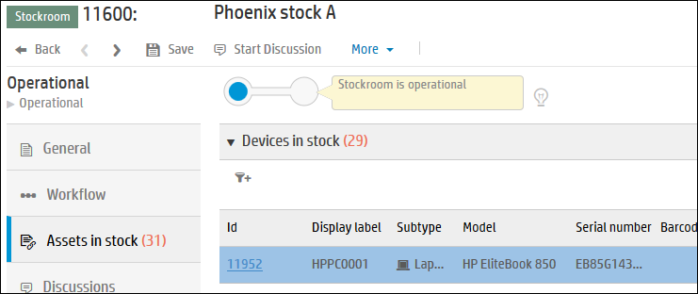
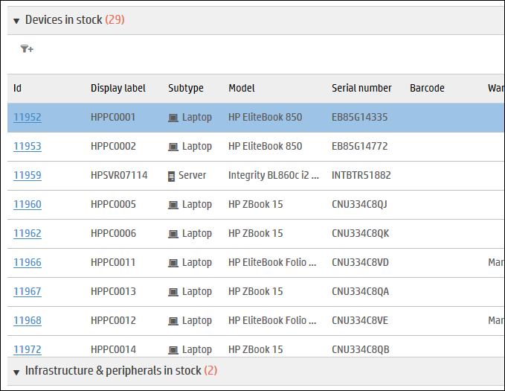
Stock Rooms: Assets in Stock
Service Asset & Configuration Management → SACM Home → Stock Management
For accelerated request fulfillment and increased asset utilization
Manage stockrooms and their location
Understand what assets are in stock and which locations can be served from this stock
Shows Devices as well as Infrastructure & peripherals in stock
Notes:
Stockrooms are physical locations where stocks and assets are stored.
You manage you stockrooms and the content of your stockrooms from the Stock Management area of the SACM module.

Slide 29
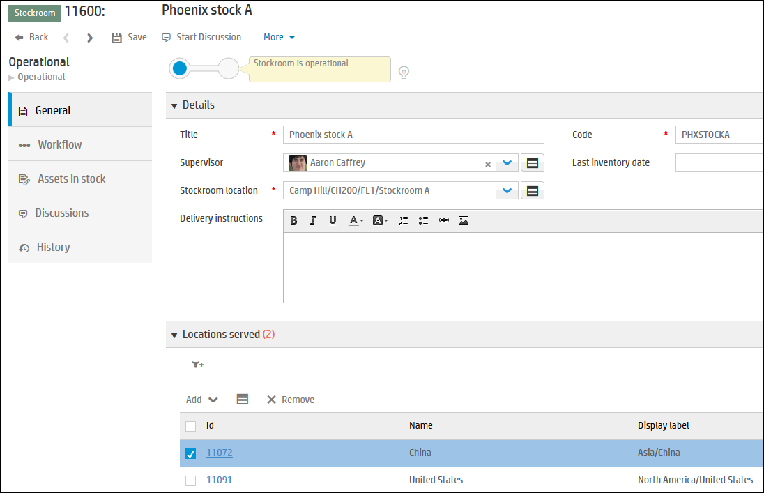
Stock Rooms: Locations Served
Locations which are served by this stockroom

Slide 30
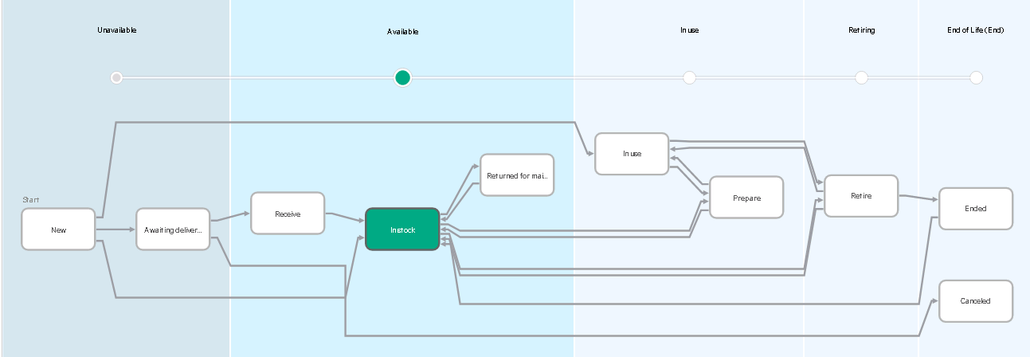
Device lifecycle phases
Asset in Stockroom
Device workflow shows it is In Stock phase
Device phases:
New
Awaiting delivery
Receive
In stock
Prepare
In use
Notes:
You record information about the content of your stockrooms from the Stock Management submenu of the SACM module.
Workflow – In stock → Prepare → In use

Slide 31
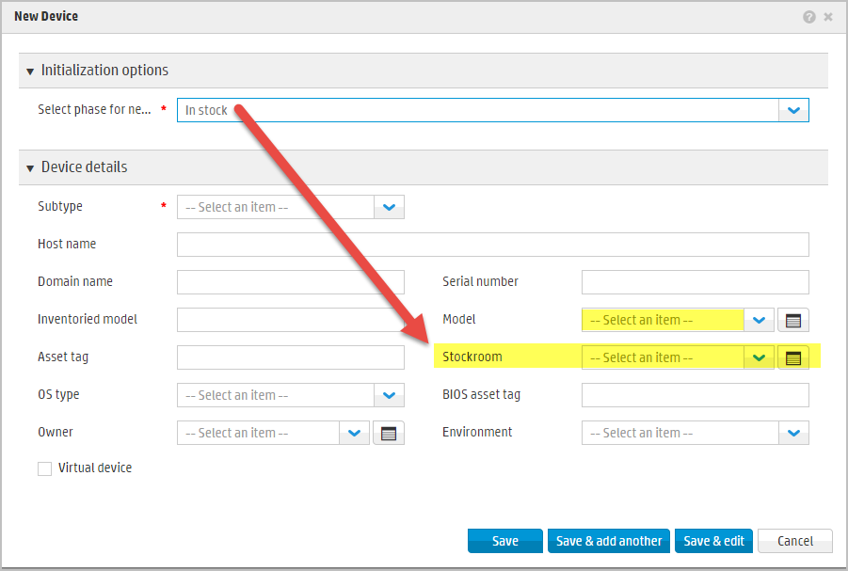
Adding Devices
Select Workflow Phase
Awaiting delivery
In stock
Prepare In use
Subtype
Model
Stockroom (dynamic)
Owner (optional)
Notes:
When a CI is in the In stock workflow phase, the Stockroom field is available.

Slide 32
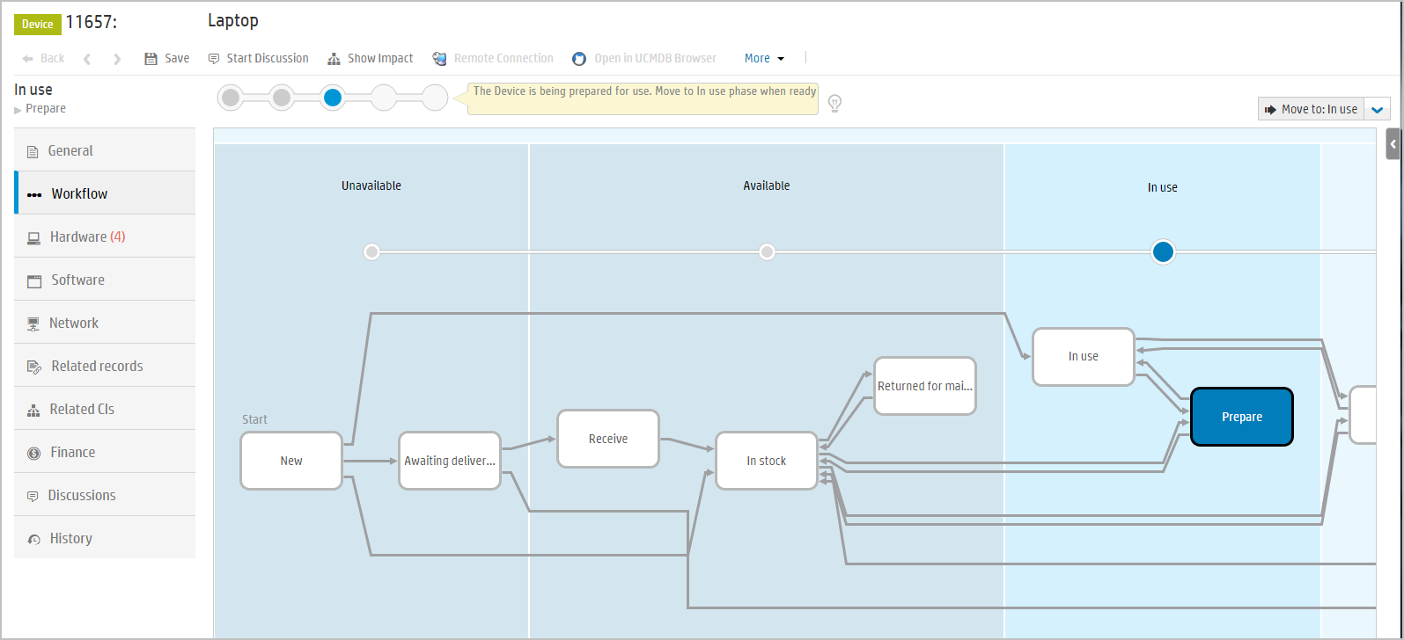
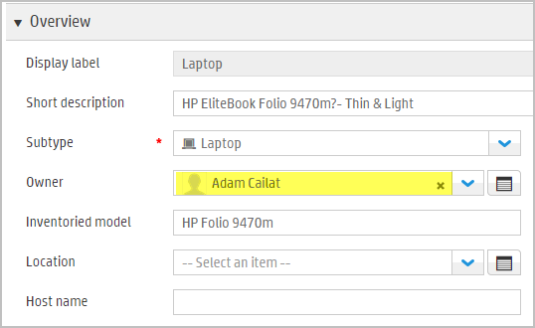
Stock Management – Transition to In Use
In Prepare phase, Device is assigned to the Requestor (automatically from the request)

Slide 33
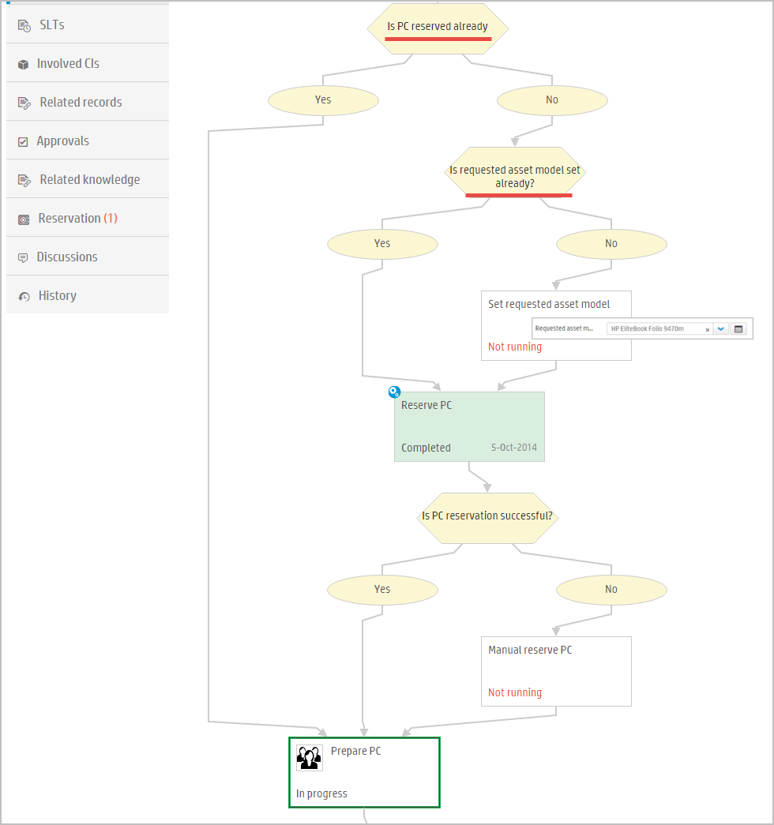
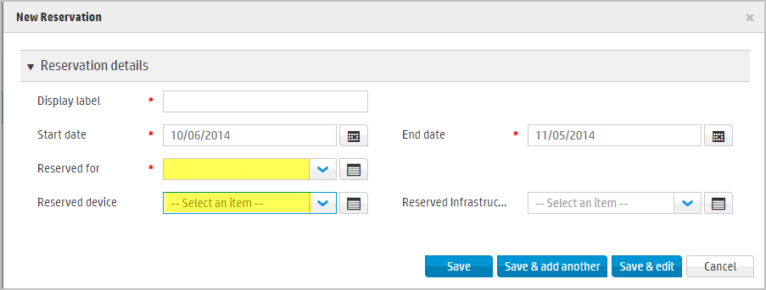
Reservations
Service Asset & Configuration Management → SACM Home → Reservations
Records are added automatically from a Request Catalog Offering when asset model in a stockroom matches Requestor location eg. (DEMO) Request a new PC
Manually added from the Request record (Reservation tab) or can be manually added as a New Reservation record

Slide 34
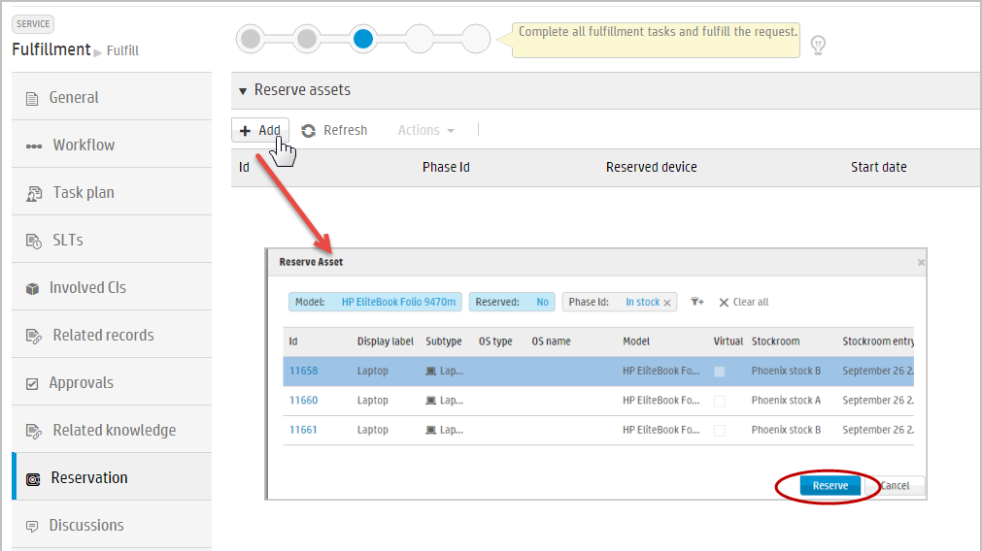
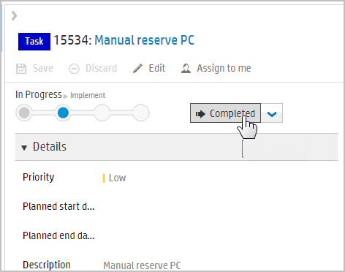
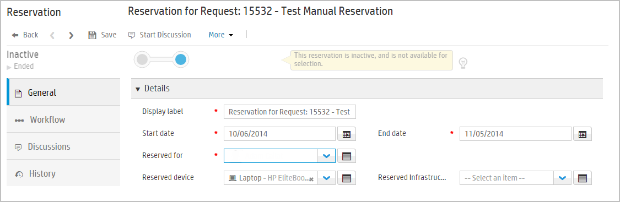
Manually Reserve Asset for End User
From the Request Record: Reservation tab → Add
Select Device & Reserve - Validate Request Task
Validate

Slide 35
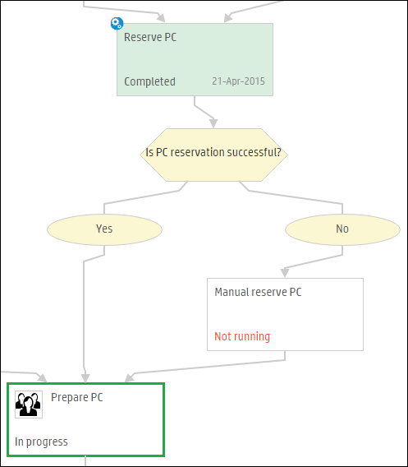
Automatically Reserve asset for End User
From the ‘Reserve asset’ rule
Reservation record automatically created in (DEMO) Request a new PC.
Things to be aware of:
In Catalog Offering, ensure the Asset Model is set either by Task or in Offering itself.
Ensure there are devices of this Asset Model in the stockroom, In stock phase.
Ensure your own location is one of the locations serviced by the stockroom.

Slide 36
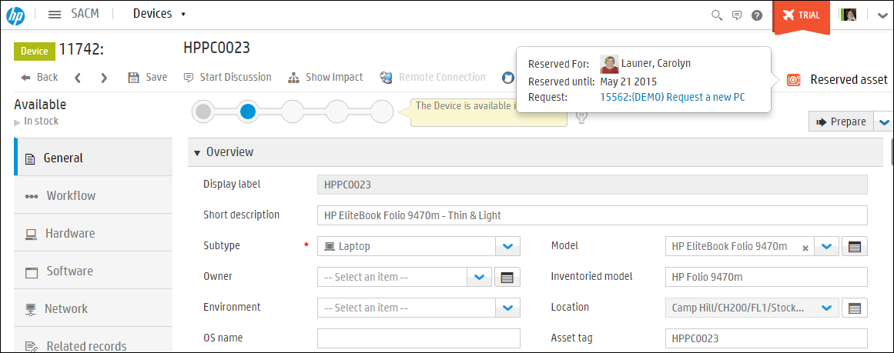
Automatically Reserve asset for End User
Device is flagged as a Reserved asset
Device is reserved and shown as being reserved for the End User.

Slide 37
Subscriptions

Slide 38
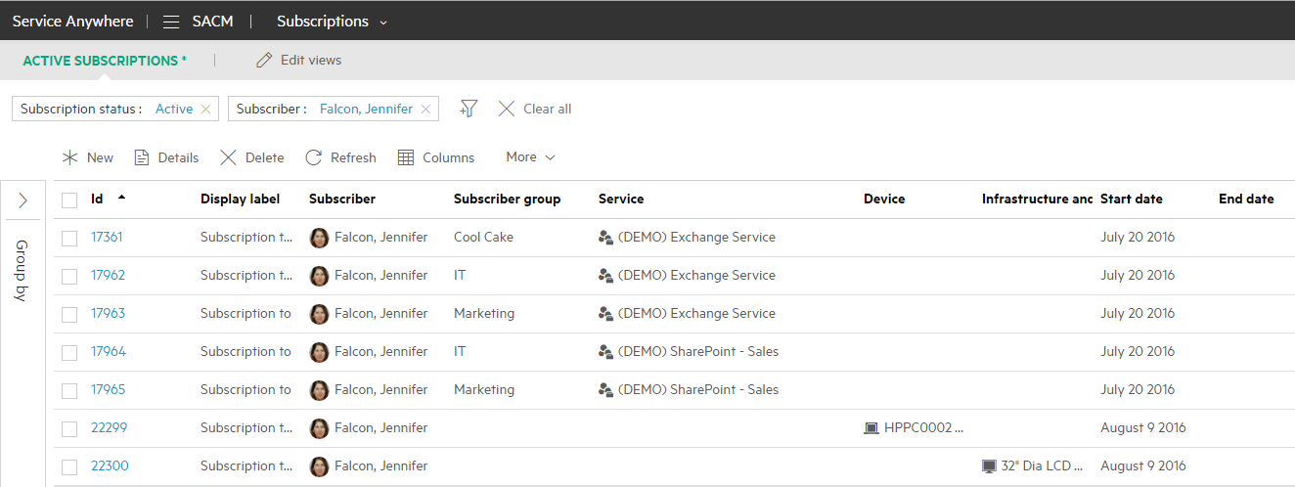
Subscriptions
Individual and Group Subscriptions
Supported for Actual Services, Devices, and Infrastructure & Peripherals
For Group Subscriptions, the Subscriber individual listed is the owner of the subscription

Slide 39
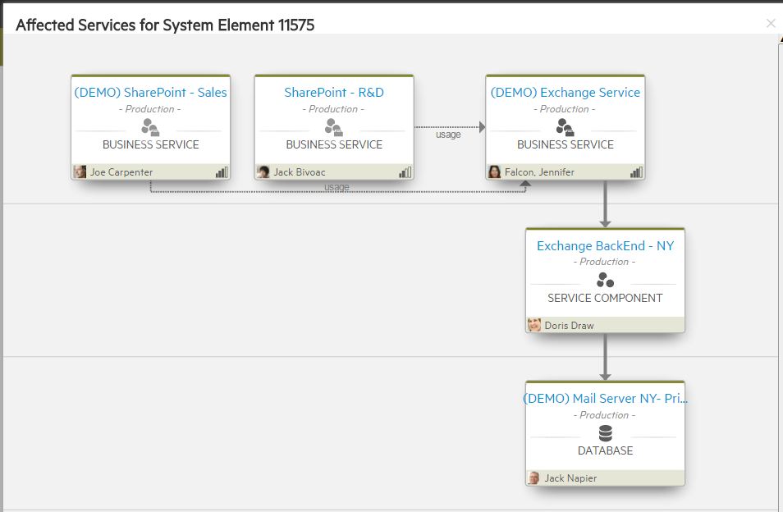
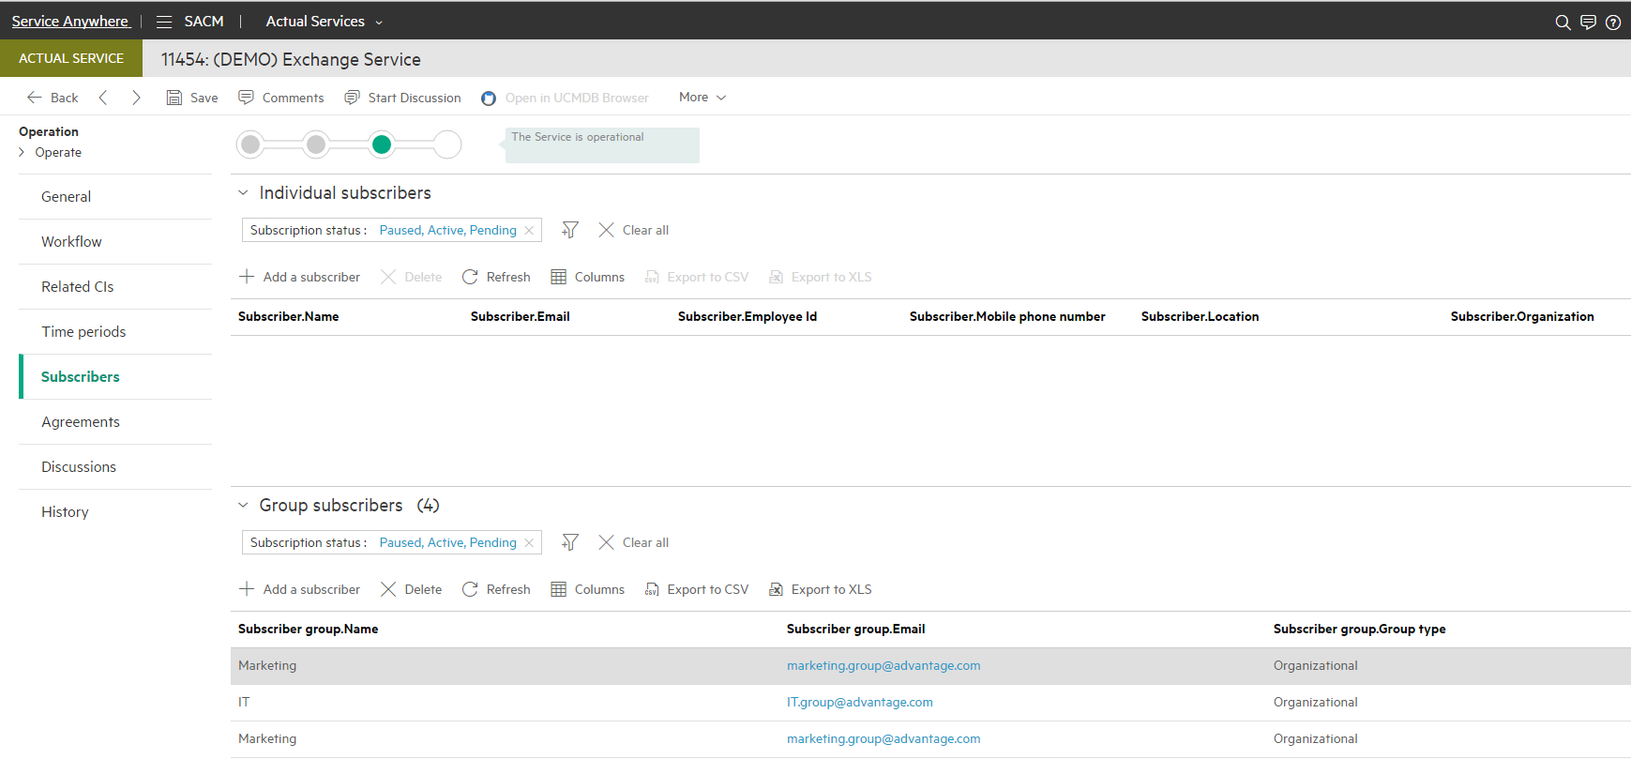
Subscriptions
Understand LOB or Customer Impact
Get list of subscribers of services involved or affected by an Incident or Change
Easily export the list of subscribers to build a consolidated report of affected subscribers reflecting the impact of the incident or change
For group subscriptions, the email address of the group (not the members of the group) is exported
Use an email client to send a message to the subscribers

Slide 40
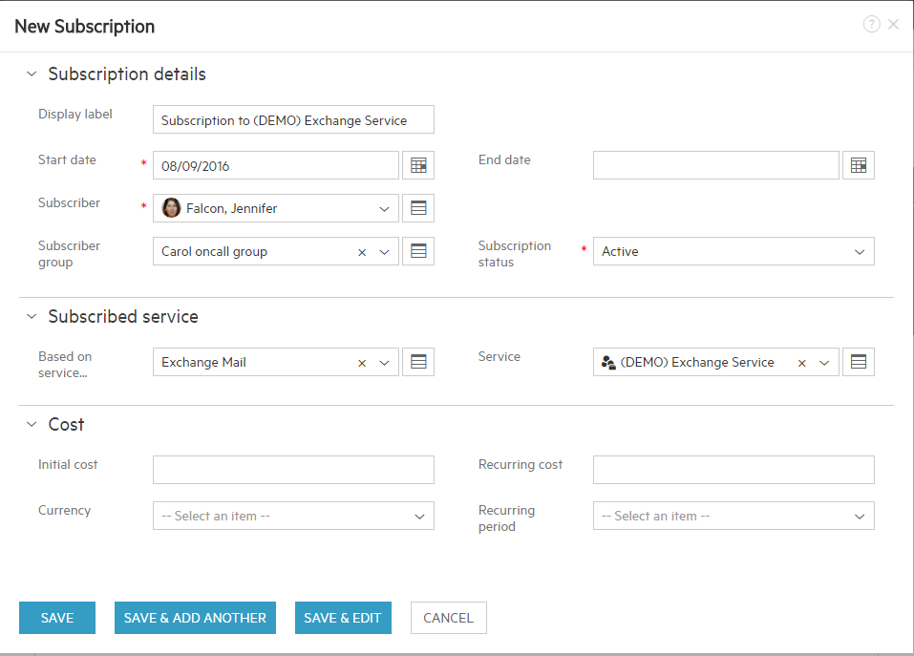
Create a group subscription
Actual Service > Subscribers tab > Group Subscribers > Add a Subscriber
Main menu > SACM > Subscriptions, *New button

Slide 41
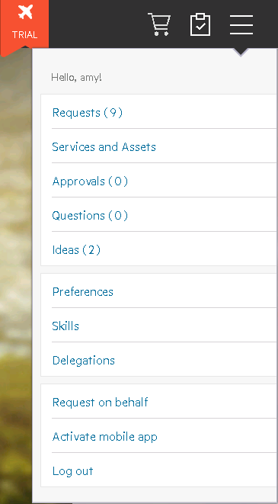
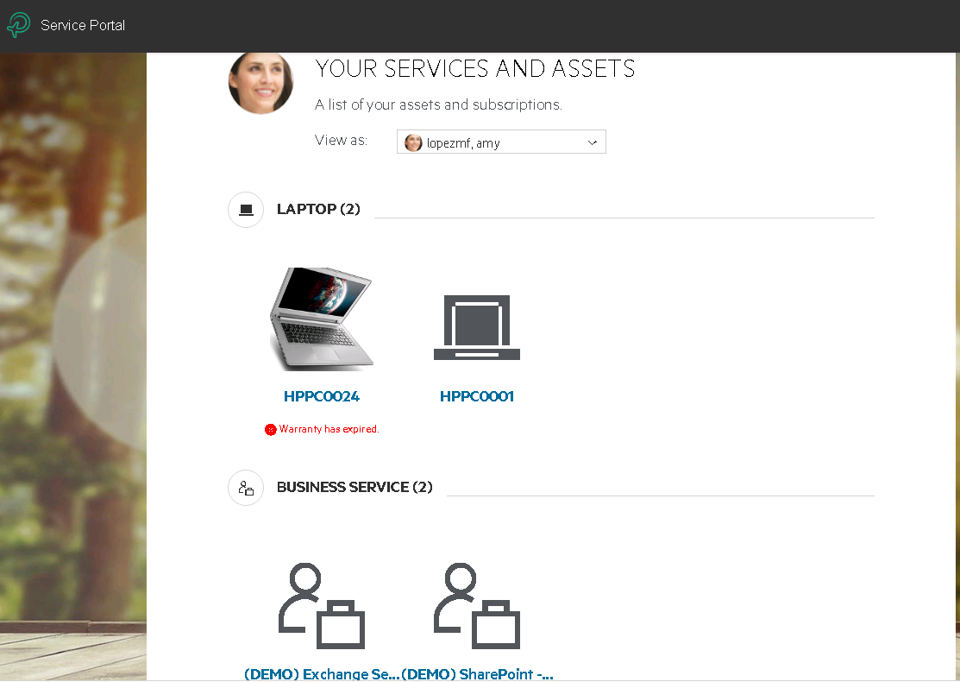
My Services and Assets

Slide 42
Contract and Vendor Management

Slide 43
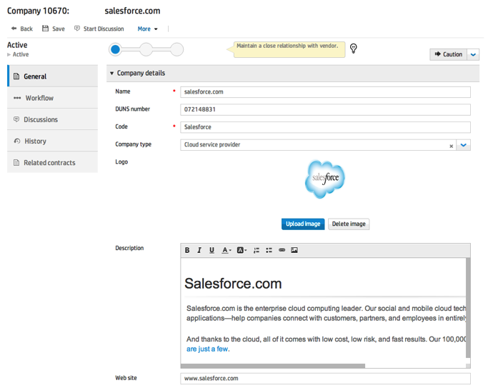
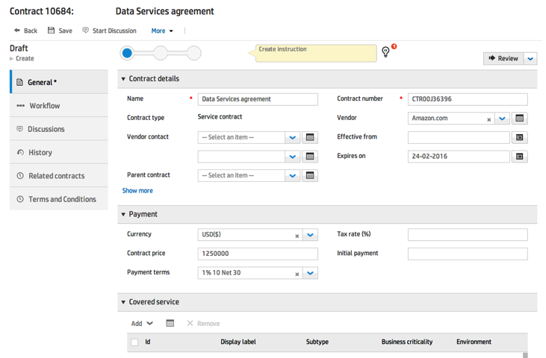
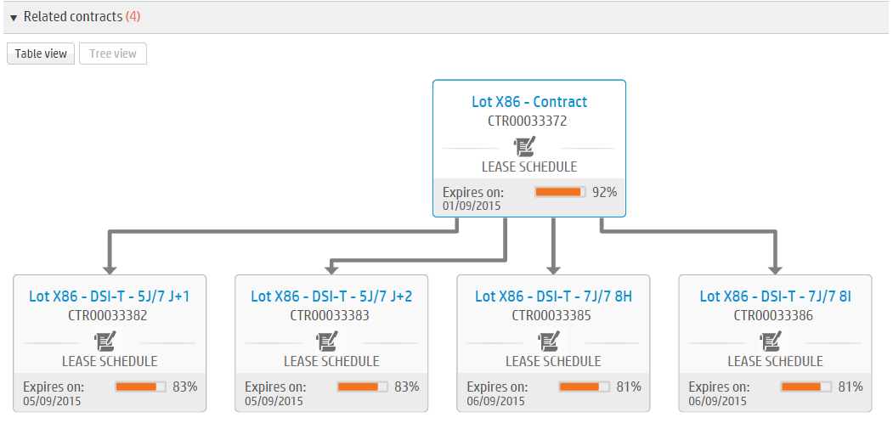
Contract and Vendor Management
Track your vendors, their brands, your vendors’ contacts and the contracts you have with them
Manage the vendor relationship by understanding which ones are subject to caution
Manage your contracts through their lifecycle, from creation through signature to expiration
Understand asset, service or person covered by a contract
Notification of contract expiration: Know when to return leased assets or renew important contracts timely
Dynamically see relevant contract information on an incident, request, asset or service
View related contracts and end of terms on a tree-view to understand contracts’ dependencies

Slide 44
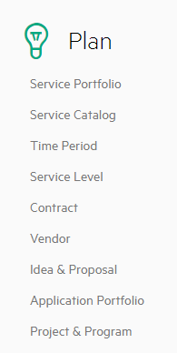
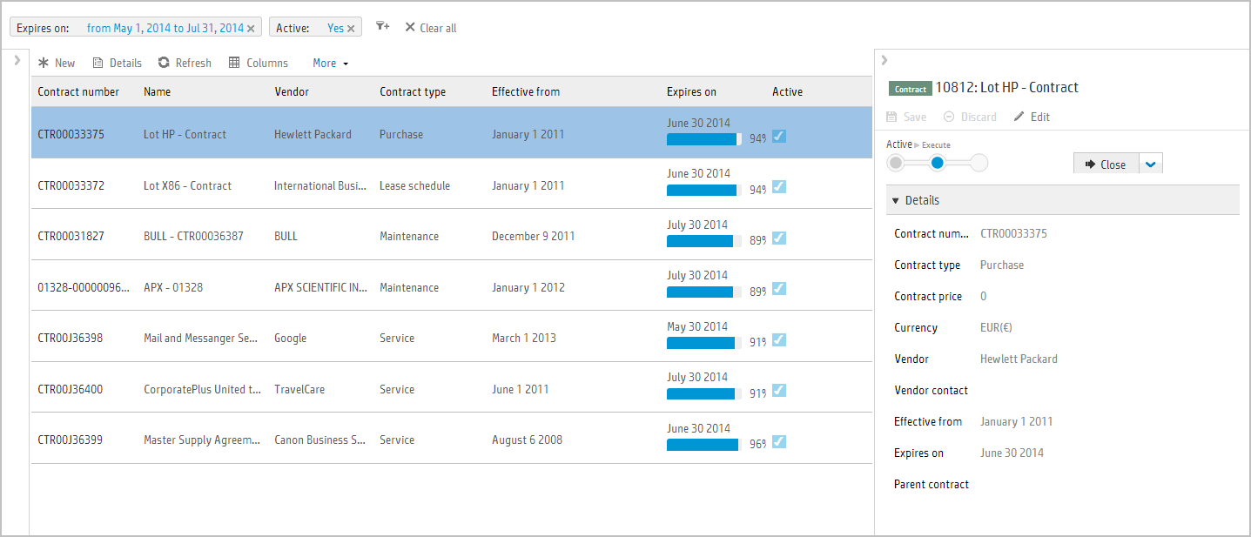

IT Asset Management: Contract Management
Contract Landing Page
Contract List/Grid
Preview
Notes:
Contract Management
Contract management or contract administration is the management of contracts made with vendors.
Contract management includes negotiating the terms and conditions in contracts and ensuring compliance with the terms and conditions, as well as documenting and agreeing on any changes or amendments that may arise during the implementation or execution of the contract.

Slide 45

IT Asset Management: Contract Management

Slide 46

IT Asset Management: Vendor Management

Slide 47


IT Asset Management: Vendor Management

Slide 48


Exercises
SACM and ITAM Quick Flow Demo Card

